Slide 1
Data Mining: Basic Cluster Analysis
Presented by Zhe Jiang
zjiang@cs.ua.edu
© Tan,Steinbach, Kumar Introduction to Data Mining 4/18/2004 <number>

Slide 2
What is Cluster Analysis?
Finding groups of objects such that the objects in a group will be similar (or related) to one another and different from (or unrelated to) the objects in other groups
Inter-cluster distances are maximized
Intra-cluster distances are minimized

Slide 3
Types of Clusters: Well-Separated
Well-Separated Clusters:
  A cluster is a set of points such that any point in a cluster is closer (or more similar) to every other point in the cluster than to any point not in the cluster.
3 well-separated clusters

Slide 4
Types of Clusters: Center-Based
Center-based
  A cluster is a set of objects such that an object in a cluster is closer (more similar) to the “center” of a cluster, than to the center of any other cluster
  The center of a cluster is often a centroid, the average of all the points in the cluster, or a medoid, the most “representative” point of a cluster
4 center-based clusters

Slide 5
Types of Clusters: Contiguity-Based
Contiguous Cluster (Nearest neighbor or Transitive)
  A cluster is a set of points such that a point in a cluster is closer (or more similar) to one or more other points in the cluster than to any point not in the cluster.
8 contiguous clusters

Slide 6
Types of Clusters: Density-Based
Density-based
  A cluster is a dense region of points, which is separated by low-density regions, from other regions of high density.
  Used when the clusters are irregular or intertwined, and when noise and outliers are present.
6 density-based clusters

Slide 7
Clustering Algorithms
K-means and its variants
Hierarchical clustering
Density-based clustering

Slide 8

Partitional Clustering
Original Points
A Partitional Clustering

Slide 9

K-means Clustering
Partitional clustering approach
Each cluster is associated with a centroid (center point)
Each point is assigned to the cluster with the closest centroid
Number of clusters, K, must be specified
The basic algorithm is very simple

Slide 10

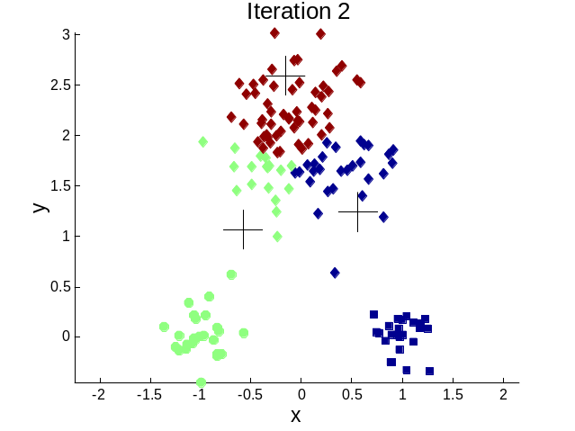




Importance of Choosing Initial Centroids

Slide 11



Two different K-means Clusterings
Original Points
Optimal Clustering
Sub-optimal Clustering

Slide 12
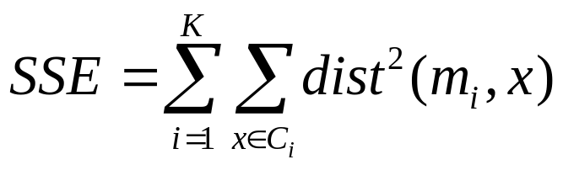
Evaluating K-means Clusters
Most common measure is Sum of Squared Error (SSE)
  For each point, the error is the distance to its centroid
  To get SSE, we square these errors and sum them.
  where x is a data point in cluster C_{i} and m_{i} is the representative point for cluster C_{i}

Slide 13


Limitations of K-means: Differing Sizes
Original Points
K-means (3 Clusters)

Slide 14


Limitations of K-means: Non-globular Shapes
Original Points
K-means (2 Clusters)

Slide 15
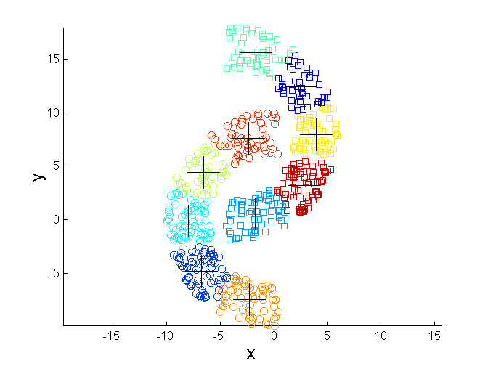
Overcoming K-means Limitations
Original Points K-means Clusters

Slide 16


Hierarchical Clustering
Produces a set of nested clusters organized as a hierarchical tree
Can be visualized as a dendrogram
  A tree like diagram that records the sequences of merges or splits

Slide 17
Agglomerative Clustering Algorithm
More popular hierarchical clustering technique
Basic algorithm is straightforward
  Compute the proximity matrix
  Let each data point be a cluster
  Repeat
  Merge the two closest clusters
  Update the proximity matrix
  Until only a single cluster remains
Key operation is the computation of the proximity of two clusters
  Different distance definitions between clusters distinguish the different algorithms

Slide 18
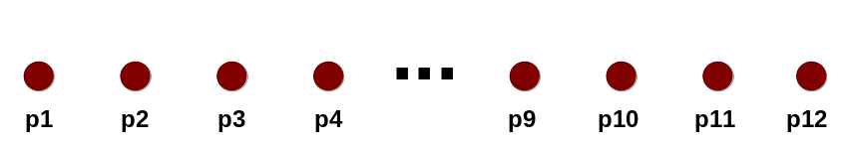
Starting Situation
Start with clusters of individual points and a proximity matrix
p1
p2
p3
p4
p5
. . .
p1
p2
p3
p4
p5
.
.
.
Proximity Matrix

Slide 19
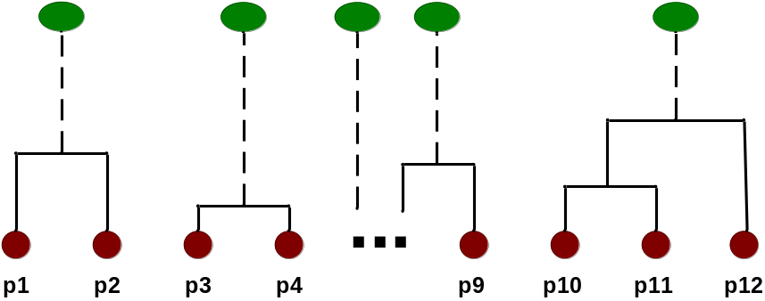
Intermediate Situation
After some merging steps, we have some clusters
C1
C2
C3
C4
C5
C1
C2
C3
C3
C4
C4
C5
Proximity Matrix
C1
C2
C5

Slide 20

Intermediate Situation
We want to merge the two closest clusters (C2 and C5) and update the proximity matrix.
C1
C2
C3
C4
C5
C1
C2
C3
C3
C4
C4
C5
Proximity Matrix
C1
C2
C5

Slide 21
How to Define Inter-Cluster Similarity
p1
p2
p3
p4
p5
. . .
p1
Similarity?
p2
p3
p4
p5
MIN
MAX
Group Average
Distance Between Centroids
Other methods driven by an objective function
  Ward’s Method uses squared error
.
.
.
Proximity Matrix

Slide 22
How to Define Inter-Cluster Similarity
p1
p2
p3
p4
p5
. . .
p1
p2
p3
p4
p5
MIN
MAX
Group Average
Distance Between Centroids
Other methods driven by an objective function
  Ward’s Method uses squared error
.
.
.
Proximity Matrix

Slide 23
How to Define Inter-Cluster Similarity
p1
p2
p3
p4
p5
. . .
p1
p2
p3
p4
p5
MIN
MAX
Group Average
Distance Between Centroids
Other methods driven by an objective function
  Ward’s Method uses squared error
.
.
.
Proximity Matrix

Slide 24
How to Define Inter-Cluster Similarity
p1
p2
p3
p4
p5
. . .
p1
p2
p3
p4
p5
MIN
MAX
Group Average
Distance Between Centroids
Other methods driven by an objective function
  Ward’s Method uses squared error
.
.
.
Proximity Matrix

Slide 25

Hierarchical Clustering: MIN
5
1
3
5
2
1
2
3
6
4
4
Nested Clusters
Dendrogram

Slide 26
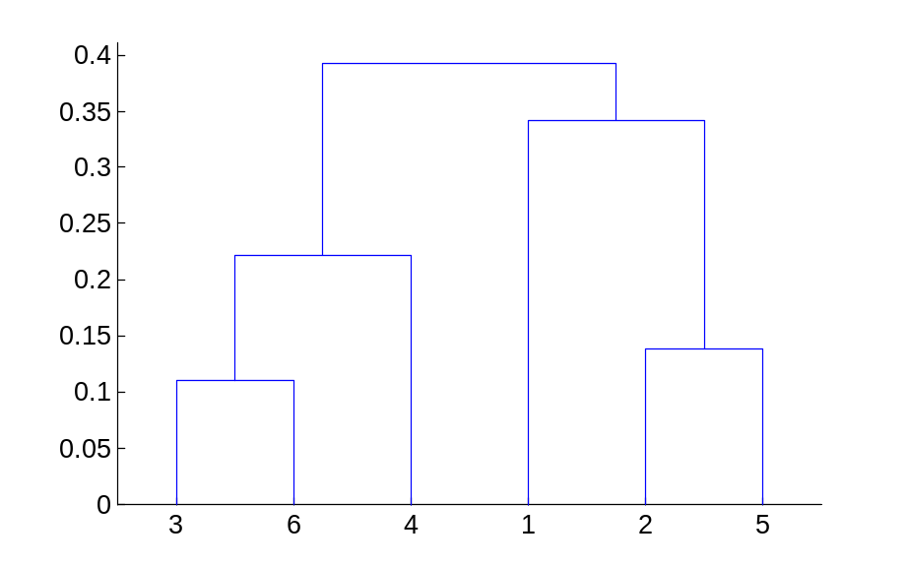
Hierarchical Clustering: MAX
4
1
2
5
5
2
3
6
3
1
4
Nested Clusters
Dendrogram

Slide 27

Hierarchical Clustering: Group Average
5
4
1
2
5
2
3
6
1
4
3
Nested Clusters
Dendrogram

Slide 28
DBSCAN
DBSCAN is a density-based algorithm.
  Density = number of points within a specified radius (Eps)
  A point is a core point if it has more than a specified number of points (MinPts) within Eps
    These are points that are at the interior of a cluster
  A border point has fewer than MinPts within Eps, but is in the neighborhood of a core point
  A noise point is any point that is not a core point or a border point.

Slide 29

DBSCAN: Core, Border, and Noise Points

Slide 30
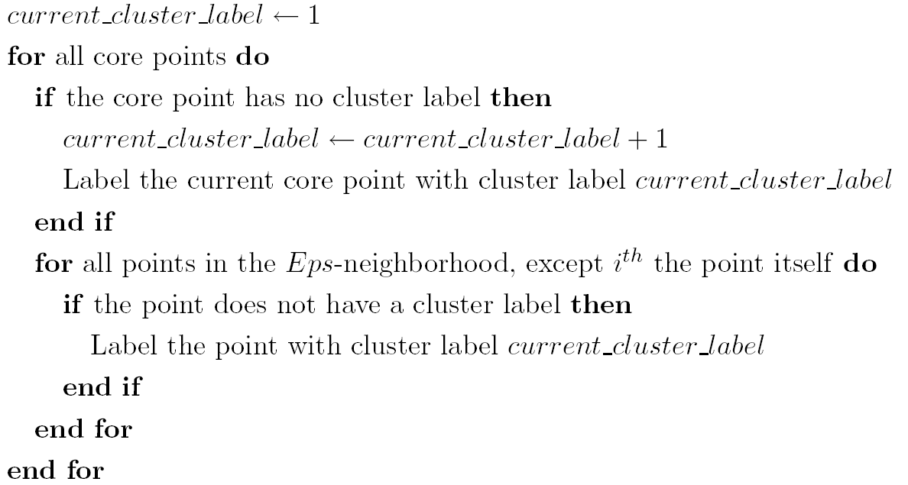
DBSCAN Algorithm
Eliminate noise points
Perform clustering on the remaining points

Slide 31


DBSCAN: Core, Border and Noise Points
Original Points
Point types: core, border and noise
Eps = 10, MinPts = 4

Slide 32

When DBSCAN Works Well
Original Points
Clusters
Resistant to Noise
Can handle clusters of different shapes and sizes

Slide 33



When DBSCAN Does NOT Work Well
(MinPts=4, Eps=9.75).
Original Points
Varying densities
High-dimensional data
(MinPts=4, Eps=9.92)

